Slide 1

Detection Of Suicidals Ideation Using Machine Learning
by
C. PAVAN SAI
Roll No. 224G5A3273
U. PALLAVI
Roll No. 214G1A321
G. RAMYA SREE
Roll No. 214G1A3284
K. KARUNA
Roll No. 214G1A32C9
Under the guidance of
Mr. E. Nagaprabhakar _{M. Tech.,(Ph.D)}
Assistant Professor
Department of Computer Science and Engineering (Data Science)
Srinivasa Ramanujan Institute of Technology
(Affiliated to JNTUA & Approved by AICTE) (Accredited by NAAC with ‘A’ Grade & Accredited by NBA (EEE, ECE & CSE)
Rotarypuram Village, B K Samudram Mandal, Ananthapuramu – 515701.
2024 - 2025

Slide 2

Contents
Planning
Requirements
UML Diagram
Data Flow Diagram
Data Processing Techniques
References
GitHub Link
Queries
Abstract
Problem Statement
Objectives
Literature survey
Proposed Work
Introduction
Existing System
Proposed System

Slide 3
Abstract
Suicide is increasingly becoming a serious concern for the society. In fact, it is one of the largest cause of deaths in today’s world. Hence it is necessary to stop this menace by developing accurate prediction systems based on available data. The paper primarily analysis the suicide data, identify significant attributes contributing towards suicide attempt and predict future such attempts with significant precision. A comparison between 2 machine learning algorithms: - Decision Tee, and Naïve Bayes for suicide prediction has been made here. The scope of this research is to understand the effectiveness of these algorithms for preventing future suicides. Analyzing and predicting suicide attempts is a complex and critical challenge in public health. This problem involves collecting and analyzing data on various risk factors, such as mental health, social, and demographic factors, to identify patterns and early warning signs.

Slide 4
Problem statement
The increasing prevalence of suicide as a major cause of death worldwide poses a significant challenge to societal well-being. Effective prevention strategies require accurate prediction systems to identify individuals at risk and enable timely interventions. This research aims to analyze suicide-related data, identify key attributes influencing suicide attempts, and compare the performance of two machine learning algorithms—Decision Tree and Naïve Bayes—in predicting such incidents. The objective is to evaluate the effectiveness of these algorithms in aiding suicide prevention efforts and reducing the occurrence of future suicide attempts.

Slide 5
Objective Of Project
The primary objective of this project is to develop a robust and accurate suicide prediction system by analyzing relevant data to identify significant factors contributing to suicide attempts.
Specifically, the project aims to identify and analyze key attributes influencing suicide attempts through data analysis. Implement and evaluate two machine learning algorithms—Decision Tree and Naïve Bayes—for predicting suicide attempts.
Provide insights to support early interventions and preventive measures, ultimately contributing to a reduction in suicide rates.

Slide 6
Literature Survey
No | Title | Author | Journal Name & Year | Methodology Adapted | Key Findings | Gaps
1 | Suicidal Ideation Detection: A Review of Machine Learning Methods and Applications. | Shaoxiong Ji, Shirui Pan, Xue Li,ErikCambria, Guodong Long. | IEEE Transactionson Computational Social Systems, 2020. | Machine Learning Techniques. | Machine learning can be effective in detecting suicidal ideation. | Limited availability of labeled data for suicidal ideation detection.
2 | A Suicidal Ideation Detection Framework on Social Media Using Machine Learning and Genetic Algorithms. | Abdallah Basyouni, Abdullah Alharbi, Hatem. | IEEE Access,2024. | machine learning classifiers and a genetic algorithm. | used machine learning algorithms were random forest, SVM and logistic regression | Lack of standardization in data collection.
3 | Detection of Suicidal Ideation in Clinical Interviews for Depression Using NLP and Machine Learning | Tim M H Li, Jie Chen, Yaping Liu. | MIR Medical Informatics, 2023. | Machine learning models | suicidal ideation from clinical interview data in patients | limited generalizability to other populations.

Slide 7
Introduction
Suicide is a significant societal concern, ranking among the top causes of mortality globally.
Despite progress in mental health awareness, there is still a critical need for data-driven methods to:
Identify individuals at risk.
Enable timely and effective interventions.
Machine learning-based predictive systems can:
Help understand patterns and factors contributing to suicide.
Provide actionable insights for prevention efforts.
This study evaluates the potential of two machine learning algorithms:
Decision Tree
Naïve Bayes

Slide 8
Exixting System
Initial accuracies reported by Decision Tree and Random Forest were 71.38%. and 54.57% respectively. Hence some hyper parameters were adjusted to improve the performances. A script was run to find out the specific value of random state parameter for which both the algorithms reported maximum accuracy. Further class weight=” balanced” parameter was set for Random Forest to deal with the unbalanced classes of the target variable (attempt suicide) in the dataset.

Slide 9
Proposed System
Seriousness of this problem has prompted research attention. This paper first analyses suicide data and identify significant attributes contributing towards suicide attempt through various visualizations. Further a comparison of the accuracies of 2 algorithms: “Decision Tree”, “Naïve Bayes” is made for future suicide prediction and prevention.

Slide 10
Planning
1. Define the problem and research objectives.
2. Set the research goals for analyzing data and comparing algorithms.
3. Collect relevant datasets from reliable sources.
4. Clean and prepare the data for analysis.
5. Explore the data to understand patterns and correlations.
6. Select key features influencing suicide attempts.
7. Implement and train Decision Tree and Naïve Bayes models.
8. Evaluate the performance of the models using relevant metrics.
9. Compare the effectiveness of Decision Tree and Naïve Bayes algorithms.
10. Conclude the findings and recommend strategies for suicide prevention.

Slide 11
REQUIREMENTS
Requirement’s analysis is very critical process that enables the success of a system or software project to be assessed. Requirements are generally split into two types: Functional and non-functional requirements.
Functional Requirements: Functional requirements define the core features that the system must provide, such as data collection, preprocessing, feature selection, and model implementation. These requirements directly relate to the system’s operations and output, ensuring that the end user’s needs are met. Examples include allowing users to upload suicide-related data, implementing machine learning algorithms like Decision Tree and Naïve Bayes, and generating predictions and reports based on the model results.
Non-functional requirements: Non-functional requirements focus on the system’s quality attributes, such as performance, scalability, and security. These ensure the system operates efficiently and reliably while maintaining user privacy and compliance with data protection regulations. They also emphasize usability, maintainability, and ethical considerations, ensuring the system is user-friendly, easy to update, and follows responsible guidelines when handling sensitive data

Slide 12
Cont…
SOFTWARE REQUIREMENTS
Operating System : Windows 7/8/10
Server side Script : HTML, CSS, Bootstrap & JS
Programming Language : Python
Libraries : Django, Pandas, Mysql.connector, OS, Smtplib, Numpy
IDE/Workbench : VS Code
HARDWARE REQUIREMENTS
Processor - I3/Intel Processor
RAM - 8GB (min)
Hard Disk - 128 GB
Key Board - Standard Windows Keyboard
Mouse - Two or Three Button Mouse
Monitor - Any

Slide 13
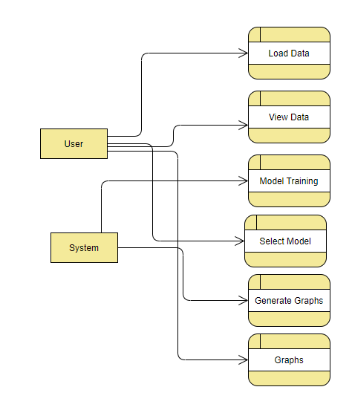
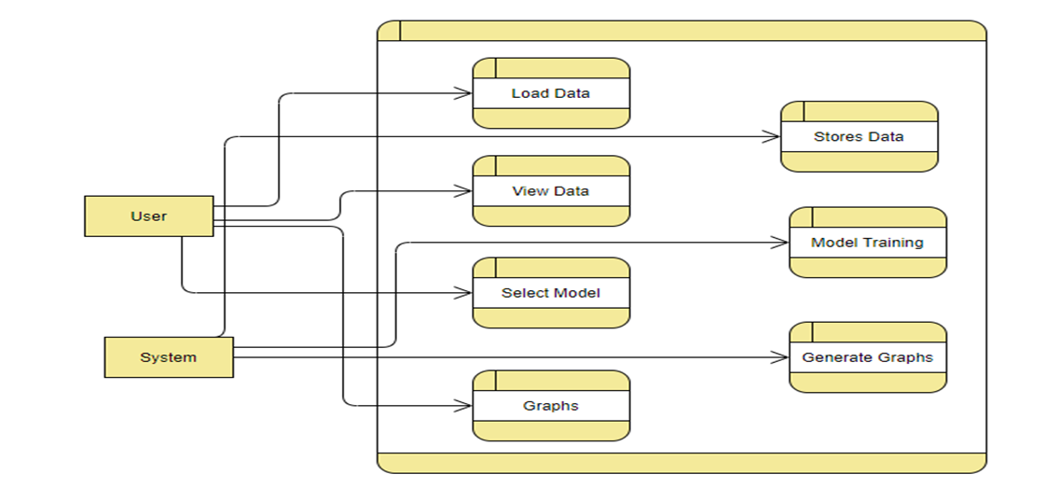
Data FlowDiagram
Figure: Working Flow of Proposed system

Slide 14
Data preprocessing techniques
Data Validation: Ensure the suicide-related datasets are of the correct type, size, and format before processing to avoid any errors in data analysis
Data Cleaning: Remove unnecessary metadata, duplicates, and incomplete records from the dataset to maintain data quality and accuracy for better predictions.
Feature Selection: Identify and retain the most relevant features (such as age, gender, and psychological factors) from the dataset that contribute to predicting suicide attempts
Data Transformation: Standardize or normalize numerical data to ensure uniformity and prevent any single feature from disproportionately influencing the model.
Handling Missing Values: Use techniques such as imputation or removal to handle missing data points that could impact the integrity of the analysis.
Feature Encoding: Convert categorical variables (such as gender, location, etc.) into numerical formats using methods like one-hot encoding or label encoding for model compatibility.

Slide 15
Contd..,
Data Splitting: Divide the dataset into training and testing sets to ensure the model can be trained effectively and evaluated accurately
Error Detection: Use checksums or hash functions to detect any corruption in the dataset during collection, upload, or preprocessing stages.
Data Augmentation: Apply techniques like oversampling or undersampling to balance the dataset, especially if the data is imbalanced between suicide attempts and non-attempts
Data Integration: Combine multiple datasets (e.g., from different regions or time periods) into a single, cohesive dataset for more comprehensive model training and better prediction performance.

Slide 16
References
[1] WHO. Causes of Death 2008: Data Sources and Methods. Department of Health Statistics and Informatics, World Health Organization; Geneva, Switzerland: 2011.
[2] Vijayakumar L. Indian research on suicide. Indian J Psychiatry. 2010;52: S291–S296. doi:10.4103/0019- 5545.69255.
[3] Radhakrishnan R, Andrade C. Suicide: An Indian perspective. Indian J Psychiatry. 2012; 54:304–19.
[4] Varnik P. Suicide in the world. Int. J. Environ. Res. Public Health. 2012; 9:760–771. doi: 10.3390/ijerph9030760.

Slide 17

Git Hub Dashboard

Slide 18
Any Queries?

Slide 19
Thank You!!!

